Slide 1
Mobile Addiction and Stress Level
Ethar Mostafa 22-101121
Arwa Mostafa 22-101120
Rana Wael 22-101219
Noureen Ibrahim 22-101056
Abdelrahman Mahdi 22-101173
Kareem ElKenany 22-101031

Slide 2
Objective
Is there a correlation between phone addiction and stress among students?

Slide 3
Datasets Used
Mobile_addiction
User_behavior
Used for Classification
Used for Regression
Both from Kaggle

Slide 4
01
Data Wrangling
Understanding the Datasets

Slide 5
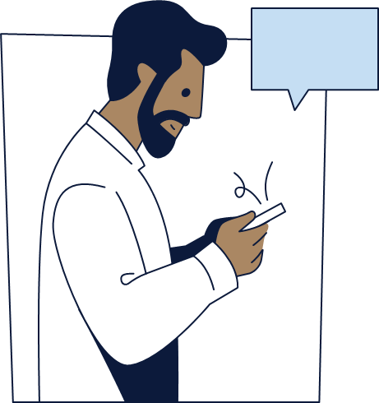
User_Behavior
This dataset includes behavioral data for 700 smartphone users.
Data Size and Structure
The dataset contains 700 rows and multiple columns representing device details, user demographics, and phone usage statistics.
Data Cleaning and Preprocessing
No missing or duplicate data was found.
Descriptive statistics (mean, standard deviation, quartiles) were calculated for all numerical variables.
Outlier detection was performed using the IQR method, but no significant outliers were identified.
The data showed logical consistency (e.g., screen time > app usage time).

Slide 6
Mobile_Addiction
This dataset includes detailed behavioral data for 13,600 participants
Data Size and Structure
The dataset originally had 13,600 records, with each row representing a participant. After removing outliers, the final size was 13,331.
Data Cleaning and Preprocessing
Checked for and confirmed no null or duplicate values.
Converted the Addicted column to a categorical variable.
Performed statistical analysis (mean, standard deviation, min, max) for all numerical columns.
Detected and removed 271 outliers using the Z-test method.
Conducted the Anderson-Darling test, which showed the data does not follow a normal distribution.

Slide 7
02
Data Visualization
Any Patterns?

Slide 8
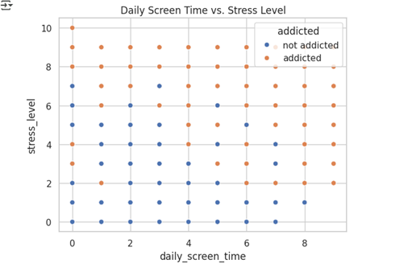
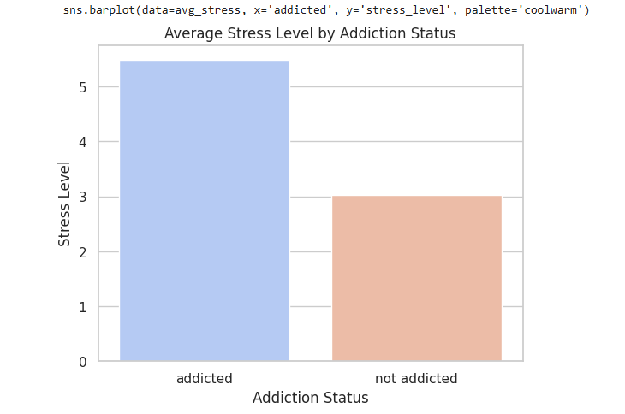
Main Plots
Shows the core link between stress and phone usage
Visually confirms that addicted users are more stressed

Slide 9
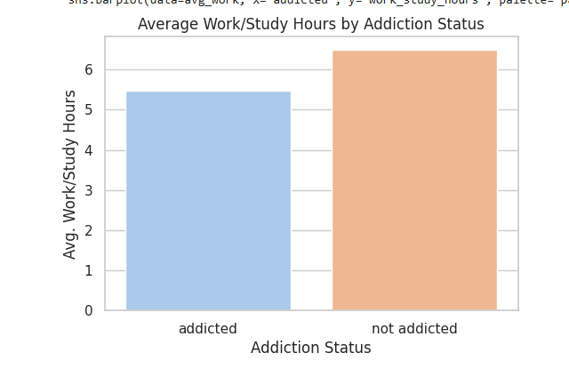
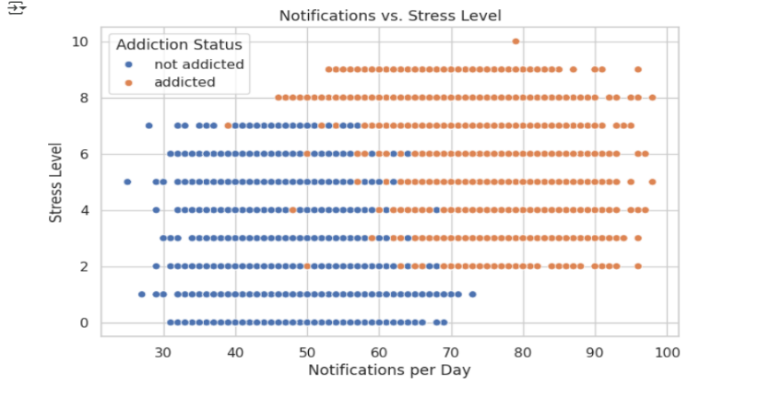
Main Plots
Shows that addiction is linked with reduced productivity
Number of notifications and stress levels are positively correlated

Slide 10
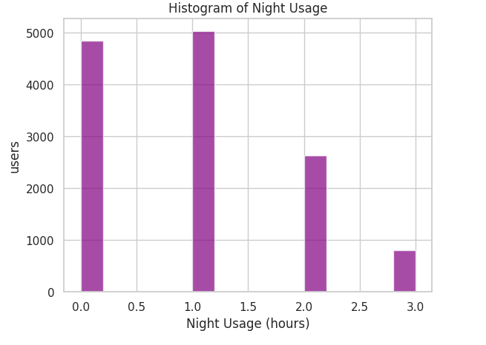
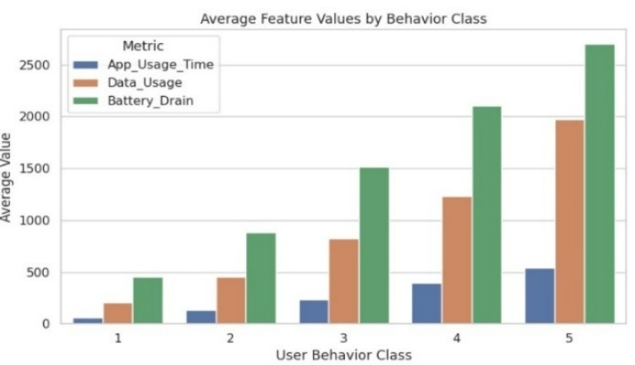
Main Plots
Shows many users are active at night, potential stress/sleep impact
Summarizes how usage intensity maps to behavior classes

Slide 11
Regression Models
03
Predict Daily Screen Time

Slide 12
Regression Models Used
Linear Regression
Ridge Regression
Lasso Regression
Uses a straight line to model the relationship between features and the output
Includes a penalty term to reduce overfitting
Uses L1 regularization to minimize the sum of squared errors
Elastic Net Regression
XGBoost Regression
Random Forest Regression
Combines L1 (Lasso) and L2 (Ridge) regularization in a single model
Builds an ensemble of decision trees sequentially
Builds multiple decision trees using bootstrapped subsets of the data
Decision Tree Regression
Uses binary trees for regression

Slide 13
Lasso Regression
• Adds a penalty to the model that discourages large coefficients.
• Shrinks some coefficients to exactly zero, effectively removing them.
• Useful when dealing with many features, especially if some are irrelevant.
Its steps are:
Fits a linear model but adds a penalty for using too many or too large coefficients.
As the penalty strength increases, more features are excluded by setting their weights to zero.
Helps prevent overfitting and improves model interpretability.
Best used when you suspect that only a few input variables are significant.

Slide 14
Elastic Net Regression
Combination of Lasso and Ridge
Merges the benefits of both Lasso (feature selection) and Ridge (stability).
Handles multicollinearity (when features are highly correlated) better than Lasso alone.
Its steps are:
Fits a linear model while applying both L1 (like Lasso) and L2 (like Ridge) penalties.
Keeps model complexity low while still allowing some correlated features to stay in the model.
Balances between excluding unimportant features and reducing the impact of large coefficients.
Ideal for high-dimensional data where predictors are correlated.

Slide 15
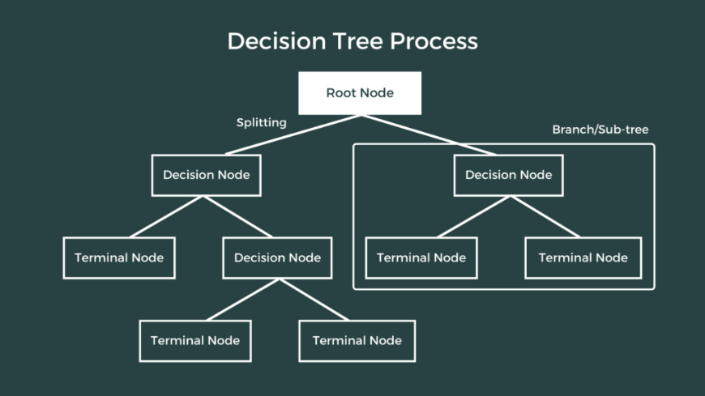
Decision Tree Regression
At each step, the tree picks the best feature and value to split the data
It uses MSE, MAE, or variance to decide the best split
It tries out all possible splits and picks the one that reduces error the most
A node is considered “pure” when all the target values are the same . i.e. zero variance
More variance means the values are more spread out
The main goal: keep splitting the data in a way that reduces variance and improves accuracy

Slide 16
XGBoost Regression
Boosted trees for powerful predictions
Builds multiple decision trees one after another.
Each tree corrects the errors of the previous ones.
Highly efficient and often used in winning machine learning solutions.
Its steps are:
Starts with a simple prediction, then gradually improves it by adding trees that fix the errors.
Each new tree focuses on the residuals (mistakes) from the last prediction.
Regularization techniques are used to avoid overfitting and ensure better generalization.
Supports features like missing value handling, early stopping, and parallel processing.

Slide 17
Random Forest Regression
Optimized version of decision trees:
addresses their limitations, such as overfitting and sensitivity to training data.
constructs a collection (or "forest") of decision trees, each trained on a different subset of the data.
Its steps are:
The algorithm generates multiple training datasets by randomly sampling from the original dataset with replacement (bootstrapping).
When constructing each tree, the algorithm selects a random subset of features (typically log2 or sqrt of the total number of features) at each split.
Each decision tree is independently trained on its respective bootstrapped dataset using the selected random features.
When making a prediction, the input data is passed through all trees in the forest. Each tree produces a numerical prediction, and the final output is determined by averaging the predictions from all trees.

Slide 18
Regression Models Evaluation
Mean Square Error
Coeffecient of Determination (R²)
How far the model deviates from observed data
How well the model generalizes to unseen data

Slide 19
Results
Best Performance
Worst Performance
Random Forest and XGBoost, outperformed the others, achieving the highest R² scores and the lowest mean squared errors.
The Decision Tree Regressor underperformed significantly

Slide 20
Classification Models
04
Addicted or Not Addicted?

Slide 21
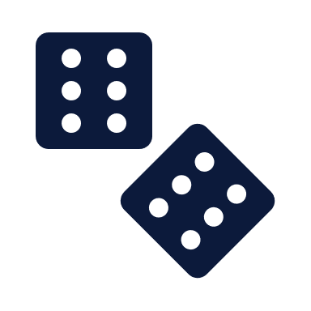


Classification Models Used
Gaussian Naïve Bays
Decision Tree
Parametric, assumes independece and normal distribution of data
Uses binary trees for classification
KNN
Random Forest
Non-Parametric. Need normalized data for fair distance calculations
Optimized version of decision tree

Slide 22

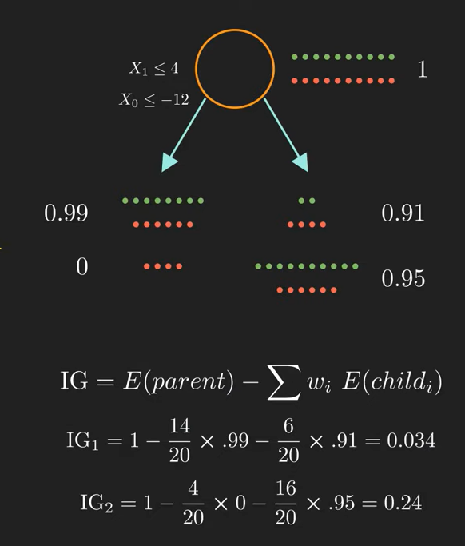

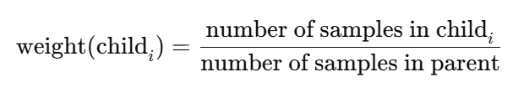
Decision Tree
The algorithm tries every possible split and chooses the split with the highest information gain.
a “pure” state (all samples belong to one class) has an entropy of 0
an entropy of 1 indicates equal probabilities of each class (in binary classification, each class would have a probability of 0.5)
The core concept behind a decision tree is selecting the best feature or best split to split the data at each node. This is done using Entropy.
Entropy is calculated as:
The algorithm calculates the entropy for each node (parent and children) then calculates the information gain using the following equation:
where wi is the weight of the ith child. it is calculated by:

Slide 23
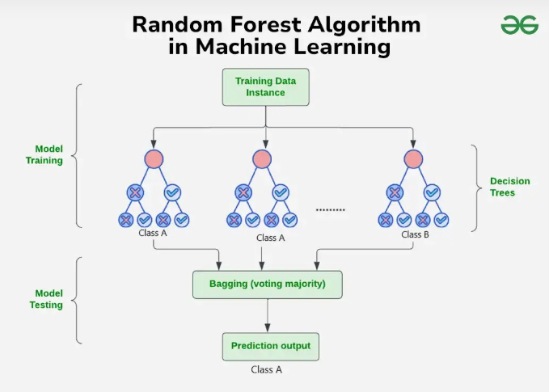
Random Forest Classification
The same as Random Forest Regression but:
When making a prediction, the input data is passed through all trees in the forest.
Each tree produces a classification result
The final prediction is determined by the most common class among all trees.

Slide 24
Classification Models Evaluation
Accuracy Score
F1 Score
Confusion Matrix
Proportion of correct predictions out of all predictions
Harmonic mean of precision and recall
Show the number of actual VS predicted classifications
AUC Score
Cross Validation AUC Score
How well the model can distinguish between classes
The average of the AUC score across multiple folds of the data

Slide 25
Results
Best Performance
Worst Performance
Random Forest and Naïve Bayes slightly outperformed others in terms of AUC and F1 balance.
Decision Tree performed the worst in terms of AUC scores

Slide 26
Findings
Clear link found between stress levels and phone addiction
Students with higher stress used their phones more, especially at night
Higher stress levels were also linked to receiving more notifications
Addicted users spent less time on work/study activities

Slide 27
Member Contributions
Data Wrangling
Data Visualization
Abdelrahman Mahdi
Noureen Ibrahim
Regression Models
Classification Models
Rana Wael
Kareem El Kenany
Ethar Mostafa
Arwa Mostafa

Slide 28
Thank You!

Slide 29
References
Zhang, A., Xiong, S., Peng, Y., Zeng, Y., Zeng, C., Yang, Y., & Zhang, B. (2022). Perceived stress and mobile phone addiction among college students: The roles of self-control and security. Frontiers in Psychiatry, 13. https://doi.org/10.3389/fpsyt.2022.1005062
Zhang, X., Gao, F., Kang, Z., Zhou, H., Zhang, J., Li, J., Yan, J., Wang, J., Liu, H., Wu, Q., & Liu, B. (2022). Perceived academic stress and Depression: The mediation role of mobile phone addiction and sleep quality. Frontiers in Public Health, 10. https://doi.org/10.3389/fpubh.2022.760387
Mobile_User_Behaviour_Dataset. (2024, November 6). Kaggle. https://www.kaggle.com/datasets/haneeshathasnin/mobile-user-behaviour-dataset
mobile addiction data. (2025, April 17). Kaggle. https://www.kaggle.com/datasets/cloudymts/mobile-addiction-data
Normalized Nerd. (2021, January 13). Decision tree classification clearly explained! [Video]. YouTube. https://www.youtube.com/watch?v=ZVR2Way4nwQ
Normalized Nerd. (2021b, April 21). Random Forest algorithm clearly explained! [Video]. YouTube. https://www.youtube.com/w
Rithp. (2023, January 16). Optimizing XGBOOSt: A Guide to Hyperparameter tuning. Medium. https://medium.com/@rithpansanga/optimizing-xgboost-a-guide-to-hyperparameter-tuning-77b6e48e289d
GeeksforGeeks. (2025, April 7). Random forest regression in Python. GeeksforGeeks. https://www.geeksforgeeks.org/random-forest-regression-in-python/
SkillCurb. (2020, September 25). What is Data Wrangling and Data Cleaning for beginners [Video]. YouTube. https://www.youtube.com/watch?v=v7RvZiMUtt0
GeeksforGeeks. (2024, July 4). Introduction to Seaborn Python. GeeksforGeeks. https://www.geeksforgeeks.org/introduction-to-seaborn-python/

